Slide 1
Lecture 10: Deep Dive into Agile
Mia Mohammad Imran

Slide 2
Recap
In last class, we talk about SDLC models:
Waterfall
Iterative
Agile
XP (a version of Agile)
We will continue Agile today

Slide 3
Objectives
Explore major Agile frameworks
Deep-dive into Scrum: Roles, Artifacts, Events
Apply Agile Estimation techniques
Discuss real-world examples from apps, media, and services

Slide 4
Agile Frameworks
Scrum – Used by Spotify teams
Kanban – Toyota’s production line
DSDM – Used in UK government digital projects
FDD – Applied at United Overseas Bank
Lean – Based on Toyota manufacturing
XP – Kent Beck’s work at Chrysler
LeSS – Scaled version of Scrum at Nokia

Slide 5
Scrum Overview
Spotify uses Scrum for each squad
Trello used Scrum-like process for product dev
Roles, Artifacts, Events align the whole team toward sprint goals
A volunteer developer group is building an app to help displaced communities find local aid centers (e.g., food, medical).
Scrum helps organize weekly progress: map updates, backend for aid centers, and feedback forms for refugees.

Slide 6
Scrum Roles
Product Owner: Represents the customer and stakeholders
Maintains and prioritizes the Product Backlog
Ensures that the team delivers maximum business value
Scrum Master: Facilitates the Scrum process
Removes obstacles (impediments) that hinder team progress
Coaches the team in Agile best practices
Development Team: A self-organizing, cross-functional team responsible for delivering increments
Typically includes developers, testers, designers, and analysts
Collaborates on backlog items and commits to Sprint Goals

Slide 7
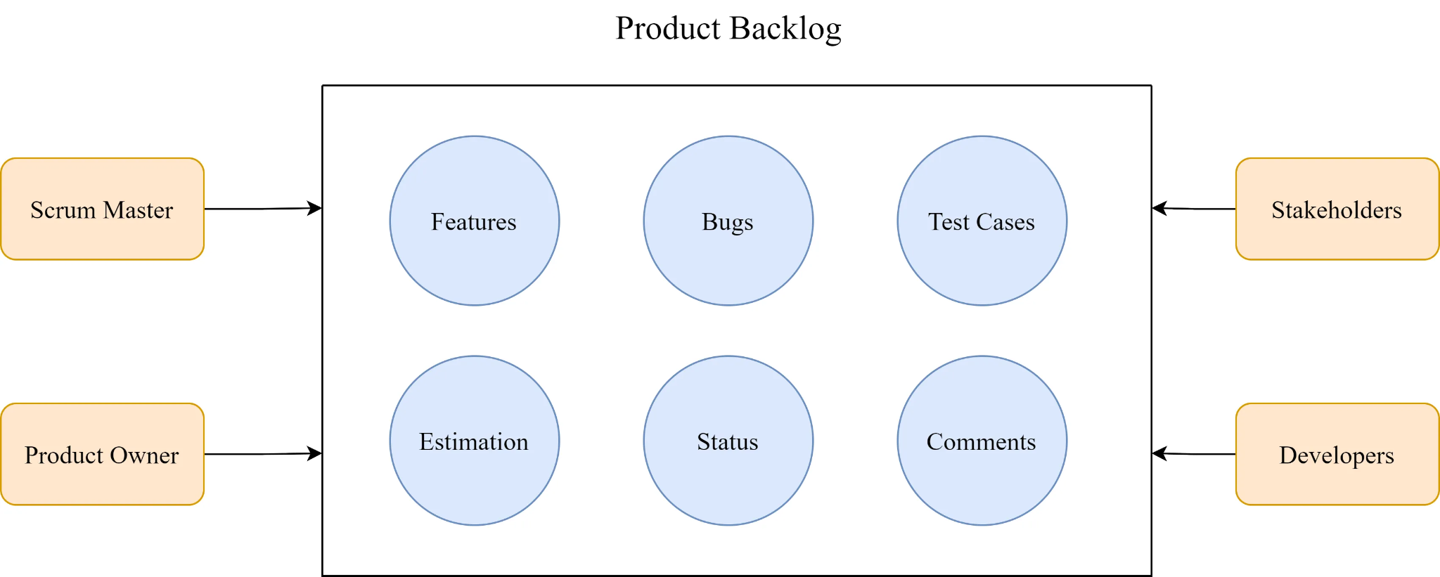
Scrum Artifacts
Product Backlog: Like a wishlist in an e-commerce app
Sprint Backlog: What gets packed for delivery
Increment: Working feature delivered, e.g., “Dark Mode” toggle

Slide 8
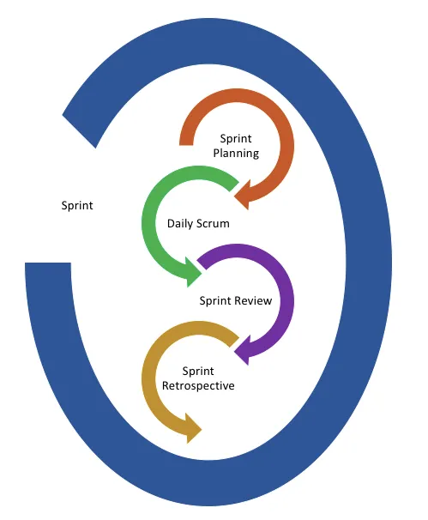
Scrum Events
Sprint Planning
Daily Scrum
Sprint Review
Retrospective

Slide 9
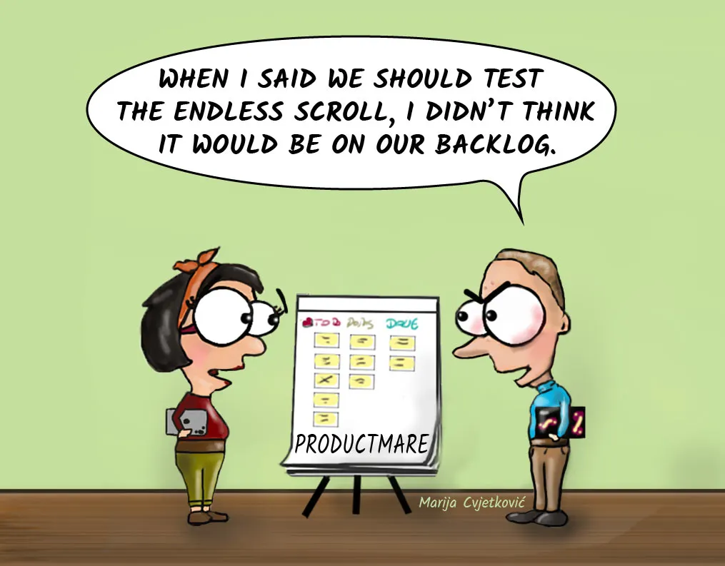
Scrum Events
Sprint Planning
Team plans work for next 2-4 weeks
Sets clear, achievable goals
Determines what can be delivered

Slide 10
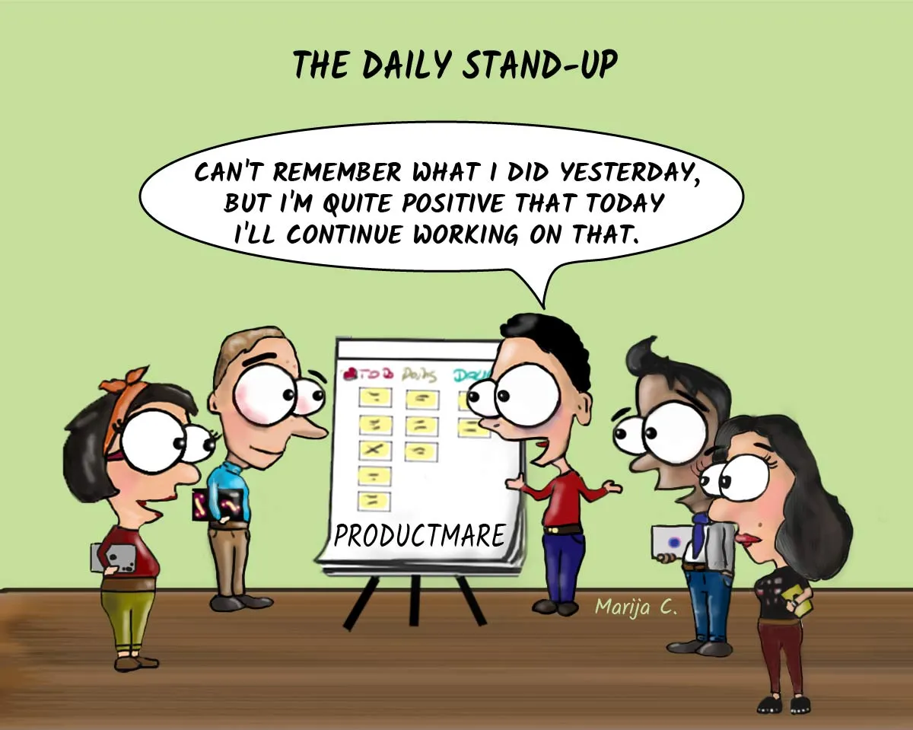
Scrum Events
Daily Scrum
Quick 15-minute team sync
Share progress and roadblocks
Ensure team alignment

Slide 11
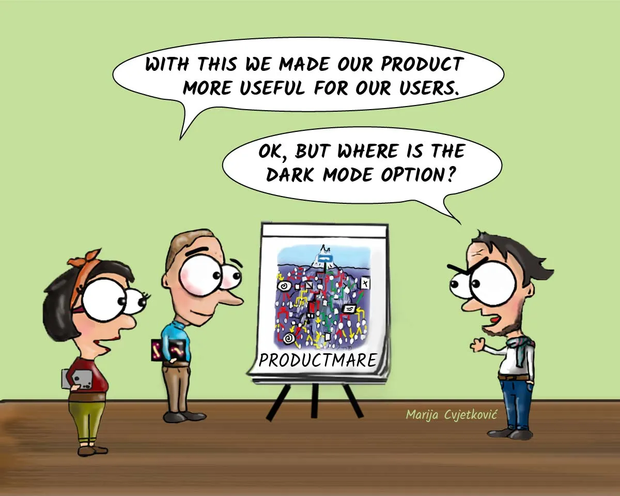
Scrum Events
Sprint Review
Demonstrate working features
Collect stakeholder feedback
Validate work against goals

Slide 12
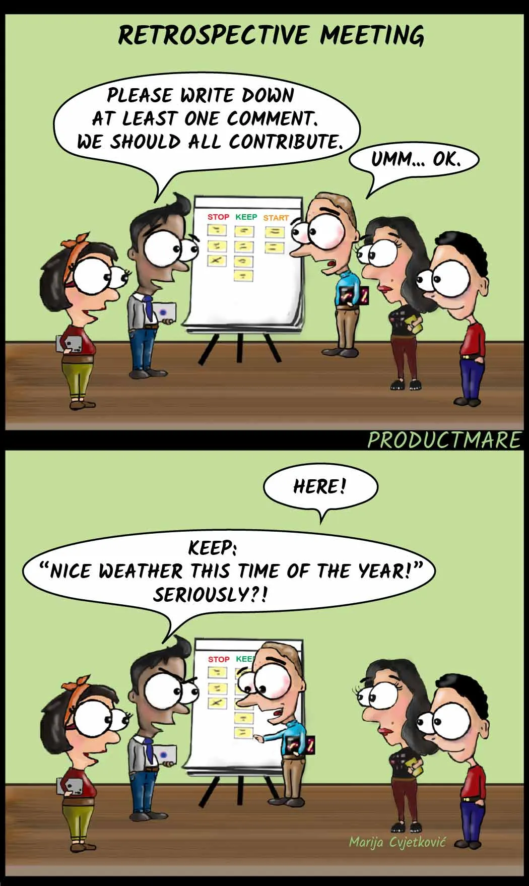
Scrum Events
Sprint Retrospective
Team reflection time
What went well?
What could improve?

Slide 13
Agile Estimating and Planning
What is agile planning
Story points
Ideal time
Estimating with planning strategies
Estimation ≠ Exact Time
Focus on relative effort, complexity, and uncertainty
Use collaborative team input

Slide 14
What is Agile Planning
Product backlogs
As a user [...] …. 5
As a user [...] …. 5
As a user [...] …. 3
As a user [...] …. 3
As a user [...] …. 2
Sprint backlogs
Code the UI 12
Write tests 5
Code middle tier 3
Update docs 6
Automate tests 4

Slide 15
Estimation by comparison
Product backlogs
As a user [...] …. 5
As a user [...] …. 5
As a user [...] …. 3
As a user [...] …. 3
As a user [...] …. 2
Sprint backlogs
Code the UI 12
Write tests 5
Code middle tier 3
Update docs 6
Automate tests 4
We are talking about this now

Slide 16

Estimation by comparison
How long it take to drive to New York from Rolla?

Slide 17

Estimation by comparison
How long it take to drive to New York from Rolla?
How long it take to read complete set of Harry Potter?

Slide 18
Estimate Size and Derive Duration
Size
Calculation
Duration
Iteration = 15 (300/20)
300 Kilograms
Velocity = 20

Slide 19
Traditional Measures of Size
Lines of Codes
Function Points

Slide 20
Problem with Traditional Measures
Requirements change frequently
Complexity is difficult to predict
Teams have varying capabilities
Unknown technical challenges emerge

Slide 21
Agile Measures of Size
Story Points – Effort-based units
Ideal Days – Work time in perfect conditions
T-shirt Sizing – Quick, intuitive sizing
Benefits
Relative sizing instead of absolute estimates
Team-based estimation
Regular re-estimation as new information emerges

Slide 22
Story Points
How long a user story will take (effort)
Influenced by complexity, uncertainty, risk, volume of the work, etc
Relative values are what is important:
A login feature is a 2
A search feature is a 6
Basic math properties should hold:
5+5 = 10
Determined by the team
Accounts for team capability differences

Slide 23
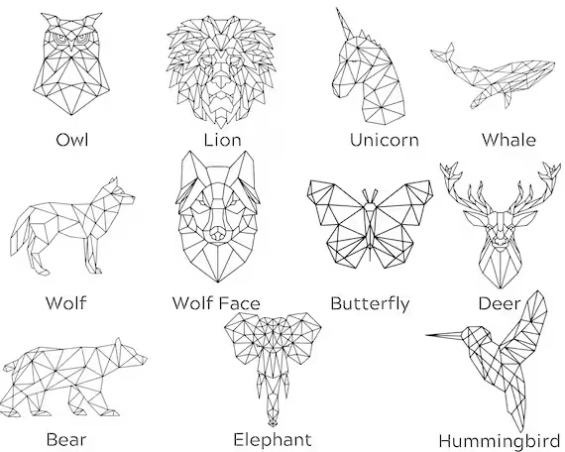
Estimation Techniques
If a Butterfly is 1 story point, how many points is an Hummingbird?

Slide 24

Estimation Techniques
Build complexity:
How many points to teach an Elephant to dance?
Elephant's weight and balance issues
Longer training time
More complex coordination
Higher risk of issues
Size is relative, and complexity matters more than just size

Slide 25
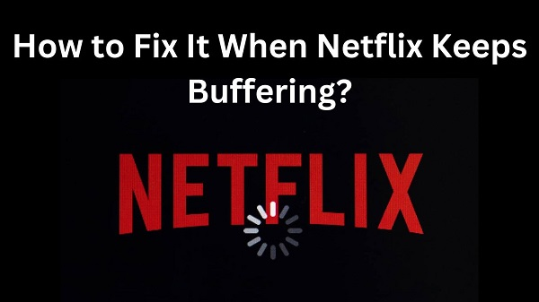
Real World Example: The Netflix Loading Bar Story
What Appears Simple:
Just a bar that shows video loading progress
Moves from left to right
Shows percentage loaded
Basic visual feedback

Slide 26
Real World Example: The Netflix Loading Bar Story
The Real Complexity:
Multiple Device Types: Smart TVs, Mobile devices, Gaming consoles, Web browsers
Each platform needs different code implementations
Different memory and processing constraints
Various screen resolutions and aspect ratios [...]
Network Conditions: Handling sudden network drops
Adjusting to bandwidth changes
Buffering strategies for different speeds [...]
User Experience Requirements:
Must feel responsive (updating frequently enough)
Accessibility considerations (screen readers, color contrast)
Different cultural expectations (right-to-left languages) [...]

Slide 27
Real World Example: The Netflix Loading Bar Story
Technical Challenges: Handling different video codecs
Managing multiple audio tracks
Dealing with subtitles/closed captions
Synchronizing with advertising breaks [...]
Edge Cases:
What happens during auto-quality switches?
How to handle when a user changes episodes mid-load?
What if the internet connection is unstable?
How to manage downloaded content vs. streaming?
What happens during system sleep/wake?
Technical Debt Considerations [...]

Slide 28
Real World Example: The Netflix Loading Bar Story
// Seems simple at first
function updateLoadingBar(percentLoaded) {
progressBar.style.width = percentLoaded + '%';
}

Slide 29
Real World Example: The Netflix Loading Bar Story
function updateLoadingBar(
percentLoaded,
deviceType,
networkSpeed,
videoQuality,
bufferState,
playbackState,
userInteraction,
accessibilityMode,
errorState,
analyticsData,
// ... many more parameters
) {
// Hundreds of lines of complex logic
// Device-specific optimizations
// Network condition handling
// Error states
// Analytics tracking
// Accessibility features
// Performance optimizations
// ... and much more
}

Slide 30
Estimation Process
Size is relative, and complexity matters more than just size
Several estimation process are proposed. We will talk some of them

Slide 31
Estimation Process: Planning Poker
Product Owner describes story
Team privately selects estimate
Cards revealed → differences discussed
Repeat until consensus

Slide 32
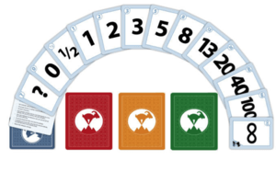
Planning Poker
1, 2, 3, 5, 8, 13, 20, 40, 100
Based on modified Fibonacci sequence
Larger gaps between numbers reflect increasing uncertainty

Slide 33
Planning Poker
0 | Task is already completed
1/2 | The task is tiny
1, 2, 3 | These are used for small tasks
5, 8, 13 | These are used for medium sized tasks
20, 40 | These are used for large tasks
100 | These are used for very large tasks
<infinity> | The task is huge
? | No idea how long it takes to complete this task
<cup of coffee> | I am hungry 🙂 or Need a Break

Slide 34
Planning Poker: "The Humanitarian Aid App"
As a civilian in a crisis zone, I want to locate nearby humanitarian aid distribution points
(So I can access food, water, or medicine safely and quickly)
Requires location services integration
Offline access for low-connectivity areas
Map integration to show aid locations
Real-time updates from volunteers
Multi-language support
Error handling for GPS issues (?)
Privacy-focused location tracking (?)
Performance optimization for older devices (?)

Slide 35
Planning Poker: "The Humanitarian Aid App"
As a field volunteer, I want to update the list of available supplies at our distribution point
Basic CRUD for supply items (e.g., water, food, medicine)
Quantity and availability toggles
Simple category tagging (e.g., medical, hygiene)
Offline support for later syncing
Basic data validation (no empty or invalid entries)

Slide 36
Planning Poker: "The Humanitarian Aid App"
As a field volunteer, I want to update the list of available supplies at our distribution point
Estimated Story Point: 5
Reasoning:
CRUD + toggles = relatively standard
Offline support adds moderate complexity
No image uploads, payment, or real-time syncing → keeps scope moderate

Slide 37
Planning Poker: "The Humanitarian Aid App"
As a donor, I want to make secure donations through the app
Integration with a secure payment gateway
Support for multiple donation methods (credit, mobile money, etc.)
End-to-end encryption and secure transmission
Transaction error handling and retry logic
Digital receipt generation and delivery (email/SMS)
Confirmation screen with donation summary
Refund request process for failed or incorrect donations
Compliance with international financial regulations (e.g., KYC, AML)
Donation history with filter and export options
Fraud detection and prevention logic (IP checks, rate limits)

Slide 38
Planning Poker: "The Humanitarian Aid App"
As a donor, I want to make secure donations through the app
Estimated Story Point: 13
Reasoning:
Involves security, finance, and user trust
Requires integration with external APIs, regulatory compliance
High risk if done incorrectly
Touches backend, frontend, legal, and UX considerations

Slide 39
Estimation Process: T-shirt Sizing
XS, S, M, L, XL, XXL sizing scale
Intuitive and familiar to most people
Good for initial rough estimation
Can be converted to story points later
More useful for Non-technical stakeholder communication
Compare items to each other instead of absolute measures
Use a reference story as baseline
Build an estimation scale progressively
Adjust estimates as team learns

Slide 40
T-shirt Sizing: "The Movie Production Studio"
Size different movie scenes:
"Two people talking in a cafe" (S)
"Car chase through city" (XL)
"Actor walking down street" (M)
"Spaceship battle" (XXL)

Slide 41
Estimation Process: T-shirt Sizing - Techniques
Team Affinity Estimation
Spread stories on table/board
Sort into size categories
Discuss boundary cases
Assign numerical values if needed
Silent Grouping
Team members arrange cards without talking
Observe emerging patterns
Discuss final arrangement
Reach consensus

Slide 42
T-shirt Sizing: "The Humanitarian Aid App"
Size different features:
"Show list of nearby aid centers" (S)
"Allow users to report supply shortages" (M)
"Send live safety alerts based on real-time updates" (XL)
"Create a system for anonymous donations with global compliance and fraud prevention" (XXL)

Slide 43
Estimation Process: Ideal Days
What is an "Ideal Day"?
Perfect workday scenario
No interruptions
No meetings or emails
Complete focus on task
All resources available
Peak productivity conditions

Slide 44
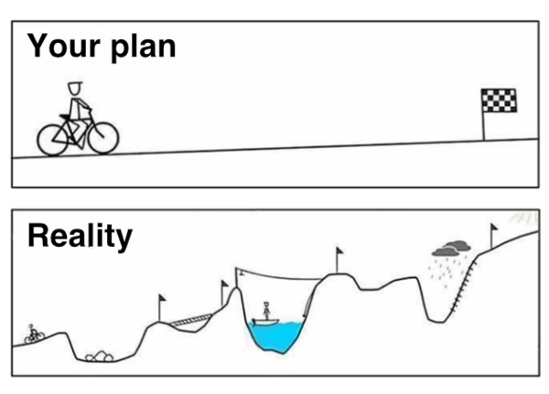
Reality vs. Ideal Days
5 ideal days ≠ 5 calendar days
Usually takes 7-10 calendar days
Why? Real world includes:
Meetings
Emails
Context switching
Unexpected issues
Team collaboration time

Slide 45
Real-World Example: User Auth Implementation
Ideal Days: 3
Actual Calendar Days: ~5-6
Time Breakdown:
Development: 3 ideal days
Daily standups: 1.5 hours
Code reviews: 4 hours
Team discussions: 2 hours
Technical issues: 3 hours
Other interruptions: 4 hours

Slide 46
Caution on Reality vs. Ideal Days
Be careful when talking about How long a story point would take
Make sure both you, scrum master and product owner all are same page
Best Practices
Define "ideal day" clearly
Track historical data
Regular calibration
Consider team maturity
Document assumptions
Review in retrospectives

Slide 47
Question For Thought
During an estimating meeting three programmers are estimating a story. Individually they estimate the story at two, four and five story points.
Which estimate should they use?

Slide 48
Question For Thought
Team A finished 43 story points in their last two-week iteration.
Team B is working on a separate project and has twice as many developers. They also completed 43 story points in their last two week iteration. How can that be?

Slide 49
Best Practices in Estimation
Calibrate using past sprints
Define what 1 point means for your team
Revisit estimates mid-project if needed
Always clarify "ideal day" expectations
Document assumptions

Slide 50
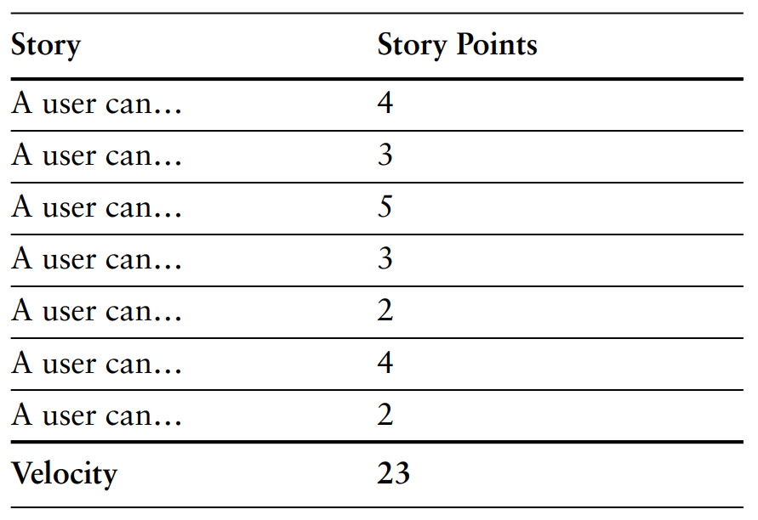
Velocity
The number of story points completed per sprint
Used to forecast team capacity
Sprint 1: 28 points
Sprint 2: 31 points
Average Velocity = 29.5 points

Slide 51
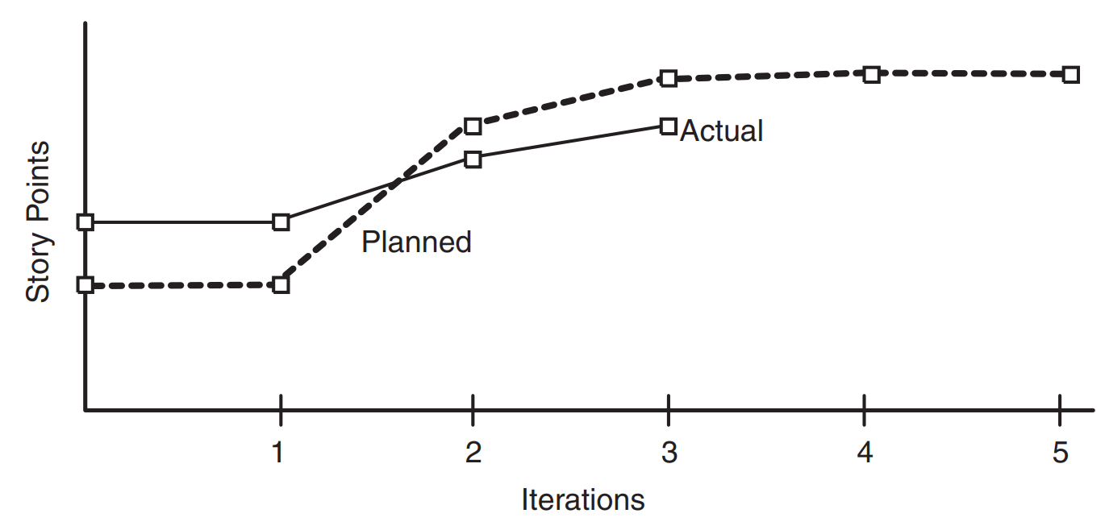
Planned and Actual Velocity

Slide 52
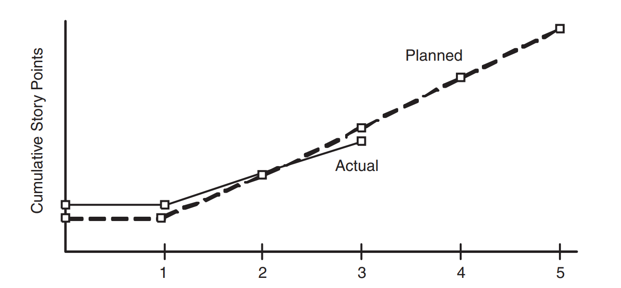
Planned and Actual Velocity

Slide 53
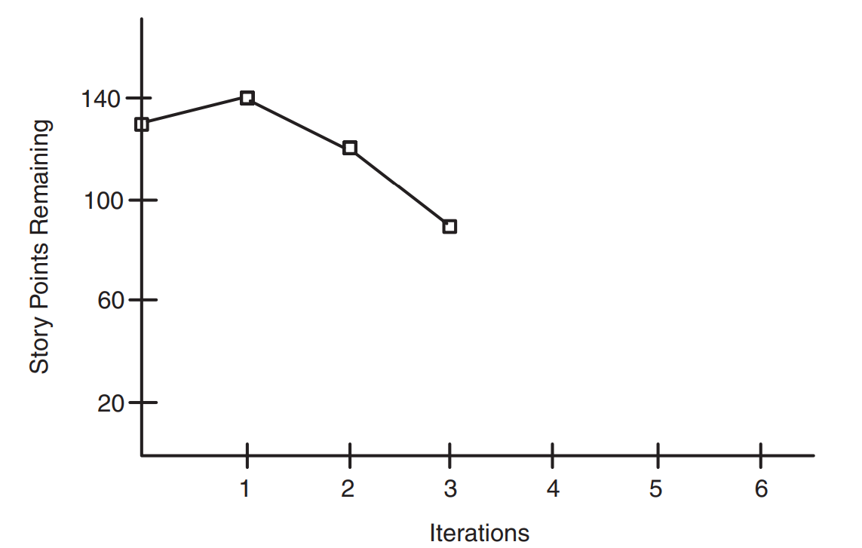
Burndown Charts
Tracks remaining story points over sprint duration
X-axis = Time, Y-axis = Points left
Why it matters:
Spot early stalls or overloads
Visualize sprint progress
Aid sprint retrospectives

Slide 54
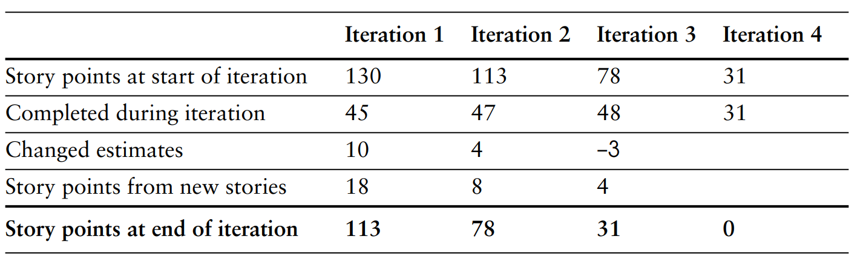
Burndown Charts are Useful

Slide 55
Agile Gone Wrong — Common Missteps
The worst thing to happen to Agile was when stand-ups turned into "how much did you get done yesterday so we don't fire you" meetings.
Stand-ups become status interrogations → Micromanagement, not collaboration
Estimation meetings feel like guessing games → Made-up numbers to satisfy someone’s spreadsheet
“Agile metrics” are used to evaluate people, not work → Velocity & story points = performance scores, not planning tools
Sprints are just rebranded deadlines aka Water-Scrum-Fall with a 2-week timer
Retrospectives result in no change → A list of team pain points... never acted on

Slide 56
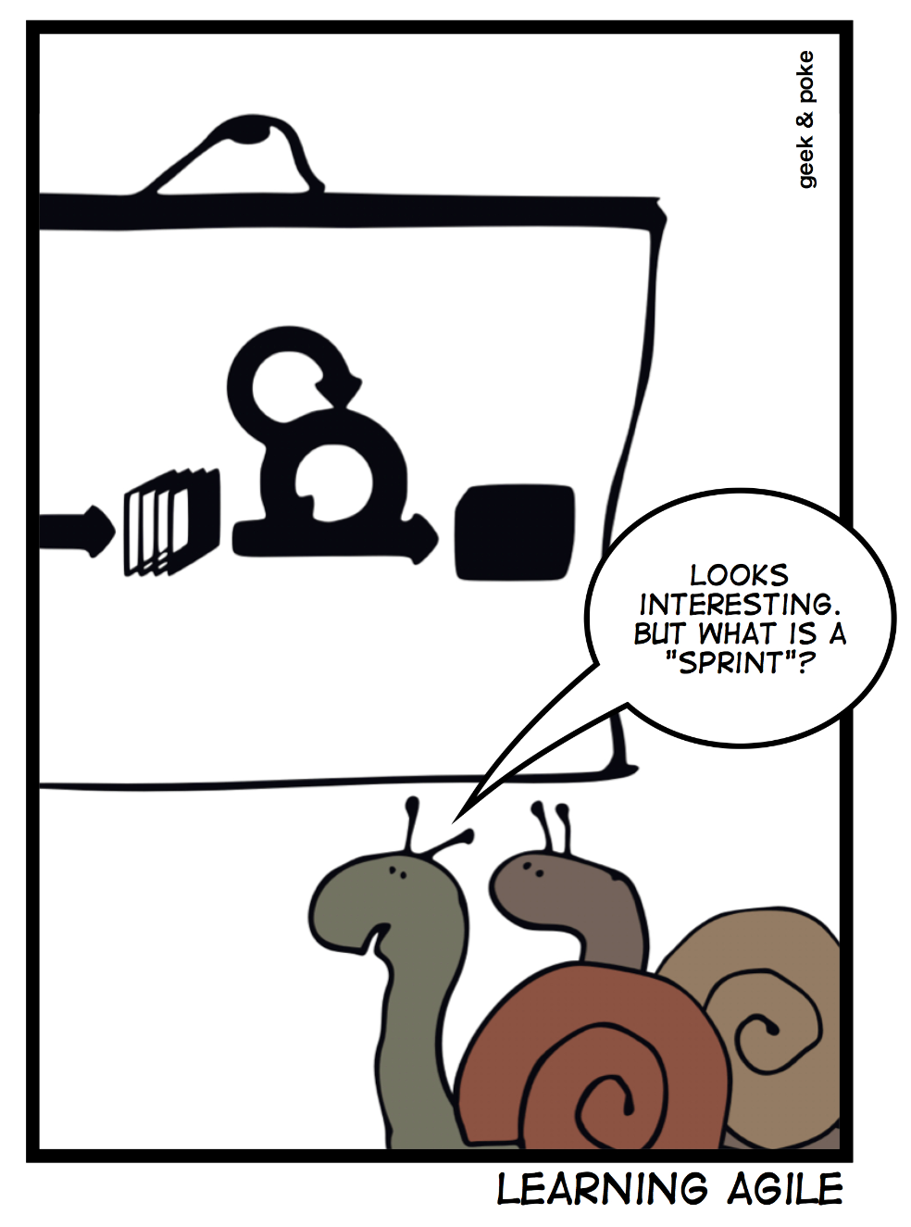
Summary
Scrum provides structure for Agile work
Estimation helps manage uncertainty and complexity
Techniques: Story Points, Planning Poker, T-shirt Sizing
Metrics: Velocity + Burndown show real progress

